Slide 1







Slide 2

Notes:
Live, Laugh, Love.

Slide 3

Notes:
Live, Laugh, Love.

Slide 4
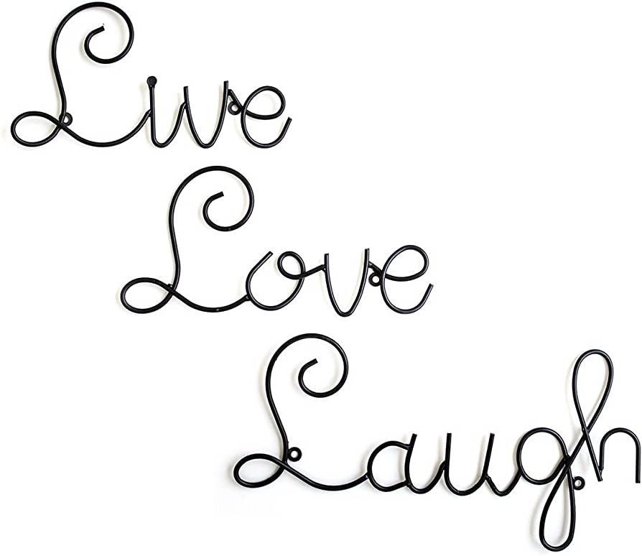
Notes:
Live, Love, Laugh?

Slide 5
Live | Laugh | Love
a critical analysis
Notes:
Live, Laugh, Love.
A critical analysis.

Slide 6


agenda
L
cultural perceptions
philosophy
live
laugh
love
conclusion
Notes:
Agenda.

Slide 7
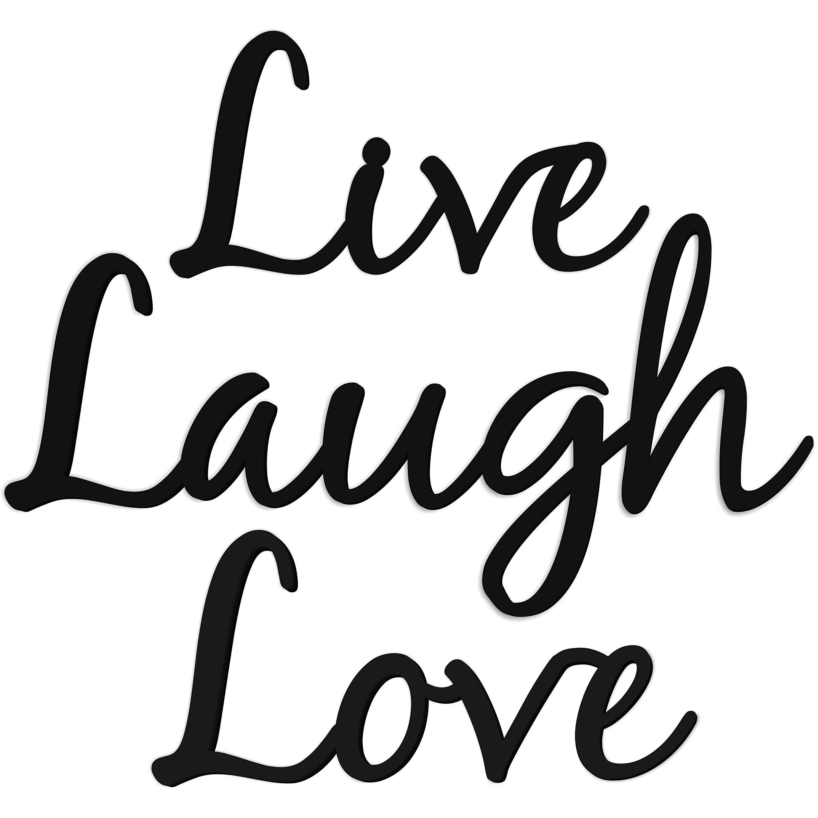
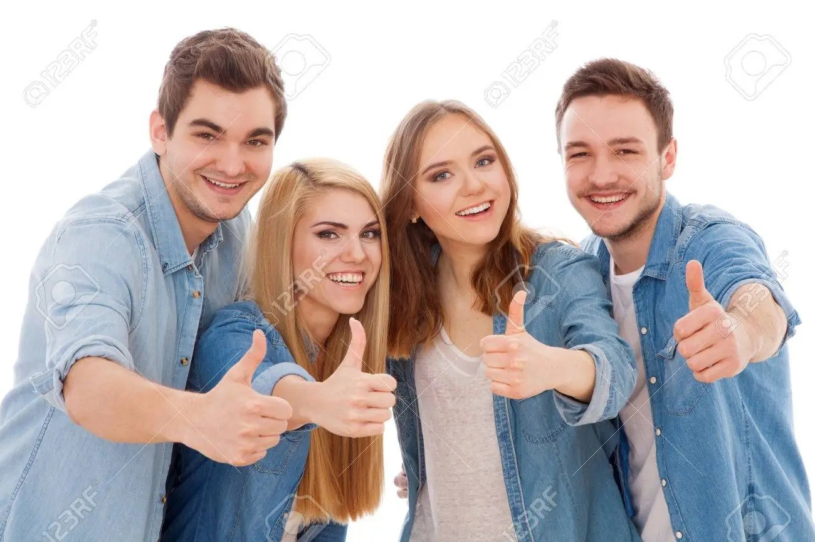
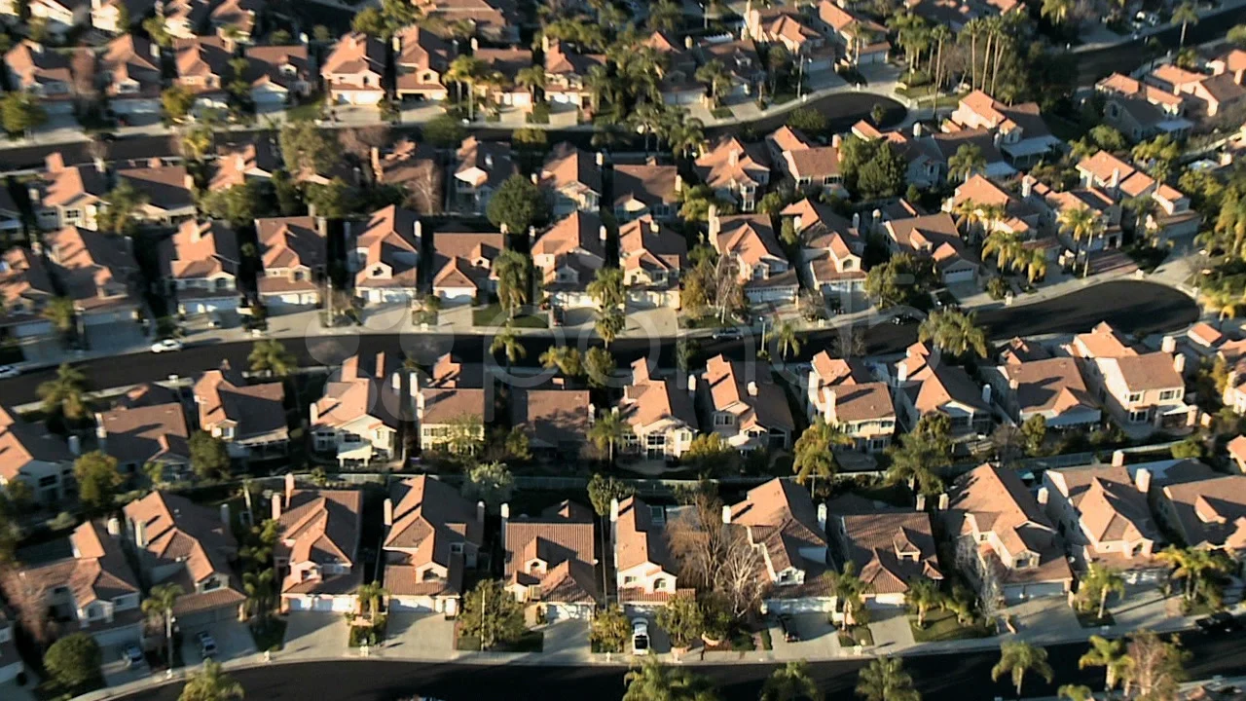


Cultural Perceptions
Notes:
Live, Laugh, Love. For many, the mere phrase conjures images of
Cookie-cutter suburbia,
Of white suburban women,
Of wine moms,
Of walking stock photographs, background characters with no personality beyond bouncy script fonts and playful alcoholism.
Most people here would probably concur that this alliterative idiom is completely devoid of any actual sentiment. There is nothing of substance behind its cheery façade. It is meaningless.
To you, I say this:

Slide 8
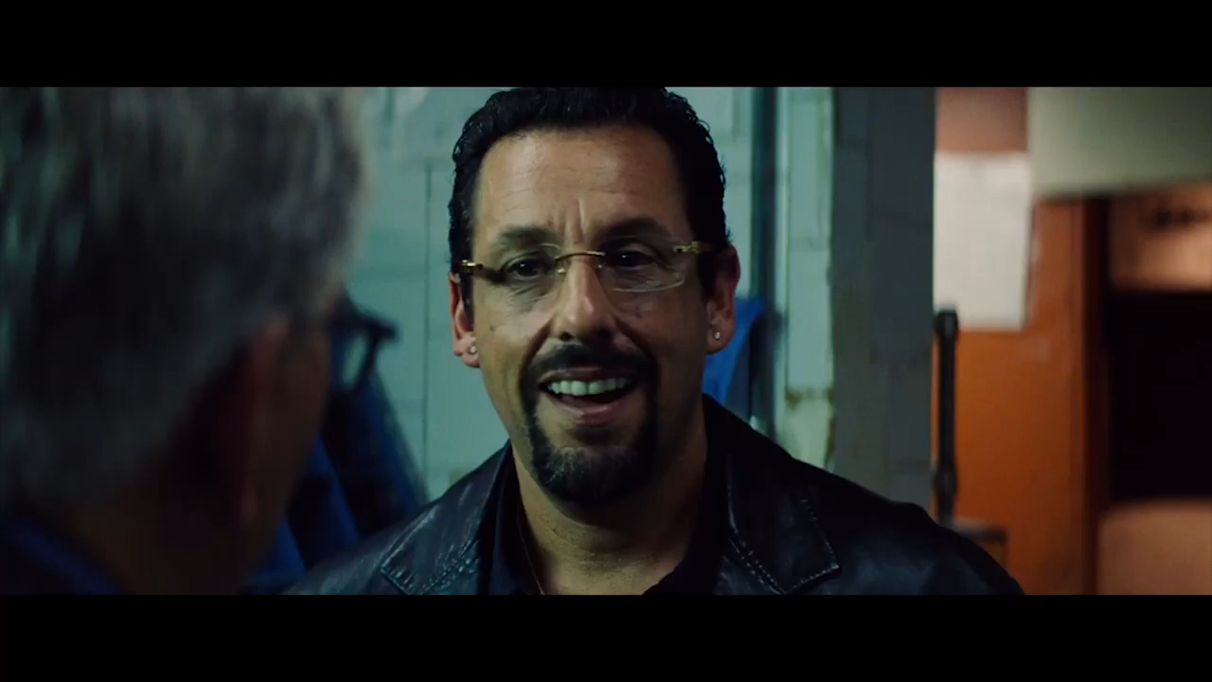
I Disagree
Notes:
… Not only is Live Laugh Love not meaningless – it may just be the most meaningful combination of words ever put together.

Slide 9
Philosophy
Live, Laugh, Love
robust / comprehensive
Notes:
Live. Laugh. Love. These three pillars embody a robust, comprehensive philosophy of life. If you abide by this doctrine without reservation, you will live the best life you can possibly live. Speaking of living, let us dive into the first principle of this eminent ideology:

Slide 10
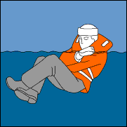


Live, Laugh, Love
Notes:
Live. Number one. That’s obvious.
Survive. Continue to exist.
This does not mean live happily.
This does not mean live successfully. This does not mean anything other than exactly what you’re already doing right now. You are here, you are alive! It’s so simple, and yet, it can be the most difficult of the three tenets to master. Life is traumatic and painful and confusing. How can you possibly deal with all this?

Slide 11

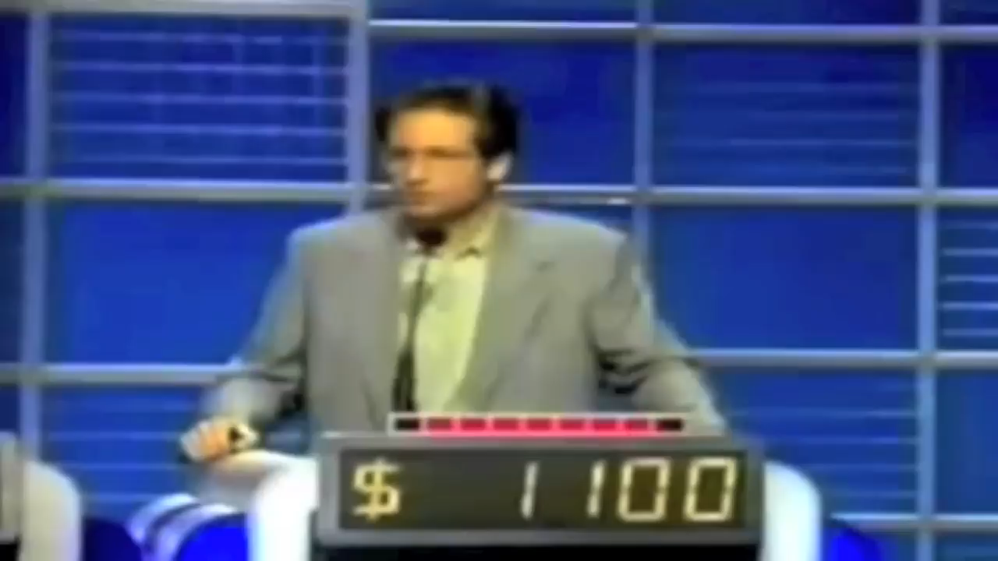
Live, Laugh, Love
Notes:
Laugh. The only appropriate response to this absurd and treacherous existence. Some dude raw dogged your mom and now you’re here, in this room, on this night, watching this stupid presentation. None of this makes any sense. No one knows how consciousness is imparted unto flesh. It’s all ridiculous and incomprehensible, so we might as well laugh. To that end, here’s one of my favorite internet videos.
Life is truly a mystery. But here, in that dumb mystery, we are together. And that brings me to my last point: Love.

Slide 12
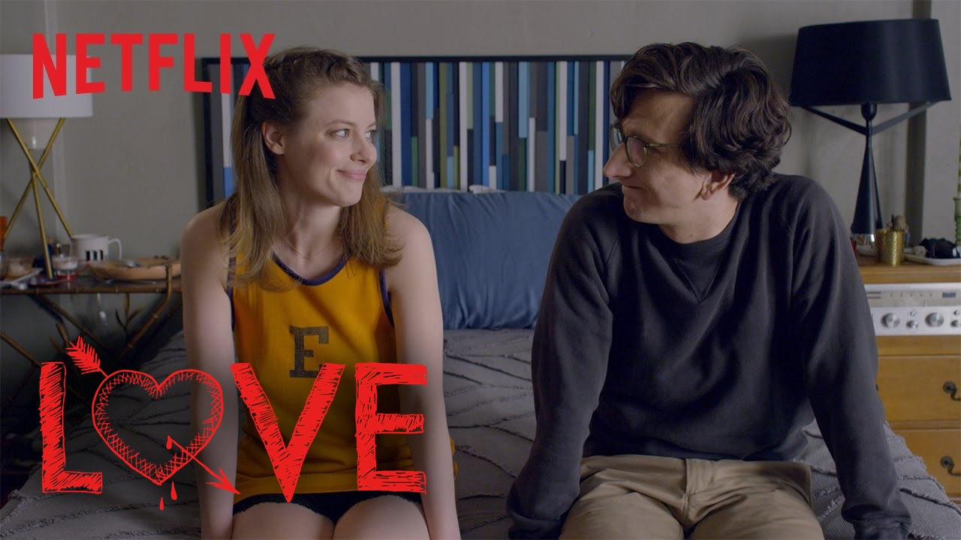
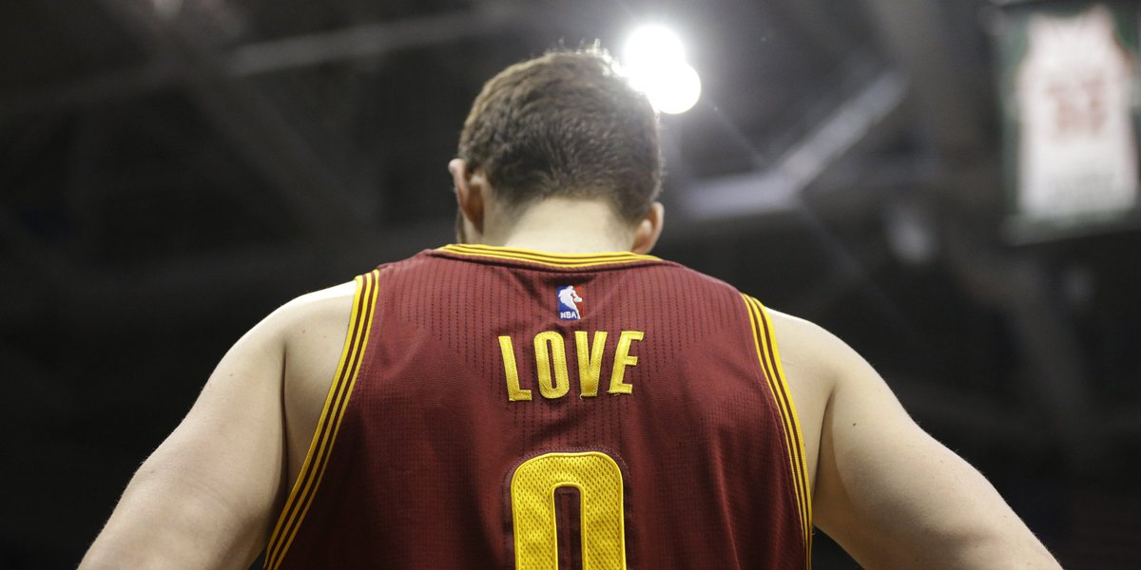
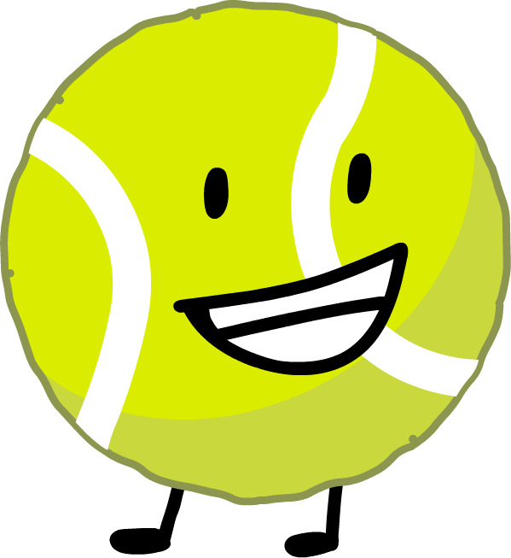
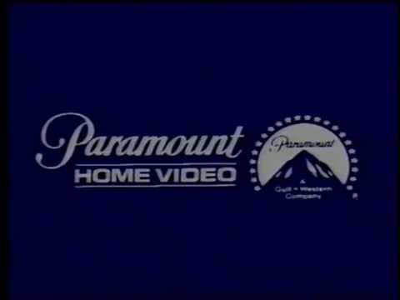
Live, Laugh, Love
Notes:
And the greatest of these is love. There’s a reason love is the final decree of this grand trifecta.
Love is so much more than a Judd Apatow-produced comedy-drama series now streaming on Netflix. And yet, some say that love is nothing.
Look to tennis, where love is 0.
Look to basketball, where Love is 0. This man has drawn a lot criticism over the years, but he played lockdown defense on Steph Curry in Game 7 of the 2016 NBA Finals, he wholeheartedly accepted his role off the bench in recent seasons and should have been sixth man of the year last year, he could get a double-double and any night of the week, he will be a Cavs legend forever even though he just got bought out - but we're not talking about Kevin. We're talking about love. Love is paramount.
Love is the most important thing. Look at me and tell me there is anything more important in this world. In your life. In this room. It may seem trivial, and in some ways, it is trivial - it is trivial because it is fundamental. We all come from love. The best parts of us come from love. By love we must live and by love we must die. And that’s all there is.

Slide 13
Conclusion
Live, Laugh, Love
live + laugh + love = $$$
Notes:
In conclusion – follow these three easy steps and you’ll be living and laughing and loving your way - all the way to the bank. Even 20th century Irish novelist James Joyce understood the power of these three L verbs.

Slide 14
They lived and laughed and loved and left
“
”
James Joyce, Finnegans Wake
Notes:
From Finnegans Wake: They lived and laughed and loved and left. What more could there be, really, to life?

Slide 15
Thank you
Live
Laugh
Battlestar Galactica
Notes:
Thank you.

